Slide 1



Physical Education
Hanmer Elementary School
“It takes a village to raise a child.”
NEXT

Slide 2
Introduction
The PE Teacher
Learning Environment
Community Outreach
Curriculum Overview
Click on the to return to this page.
Click on a tab to learn more about the PE program
BACK

Slide 3

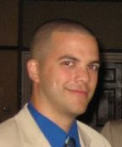

The PE Teacher
Mr. Jonathan Diaz
  Bachelor’s in PE from ECSU
  Master’s in PE from CCSU
Primary Teaching Goal:
  To increase students’ physical activity levels outside of school
Hobbies:
  Food, sleep, exercise, sports (in some order…)
Contact Information:
jdiaz@wethersfield.me
(860) 571-8370

Slide 4

Rules
Be prepared!
Be responsible!
Preparation
Wear sneakers
No jewelry
Participation
Max effort
Behavior
Respect
Responsibility
Proper use of equipment
Control body and voice
Dress appropriately
Cooperation
Listen
Follow directions
Be active!
NEXT

Slide 5
Grading
On a 1-4 scale, students earn grades in:
  Motor Skill Performance
  Applying Concepts &
  Strategies
  Physical Fitness
On a letter scale, students earn grades in:
  Responsible Behavior
4
Exceeding Grade Level Standards
3
Meeting Grade Level Standards
2
Approaching Grade Level Standards
Not Meeting Grade Level Standards
1
C
Consistent
I
Inconsistent
Needs Improvement
N
BACK
NEXT

Slide 6
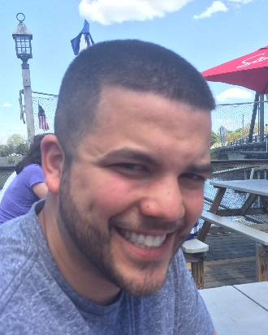
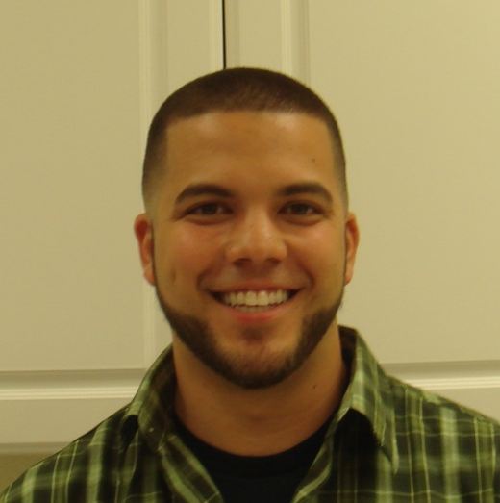
Questioning Strategies
Primary Method of Teaching:
  Questioning & Divergent Problem Solving
How can you change what you just did to make it better?
Can you find another way?
What can you do differently?
How else can you do that?
BACK

Slide 7
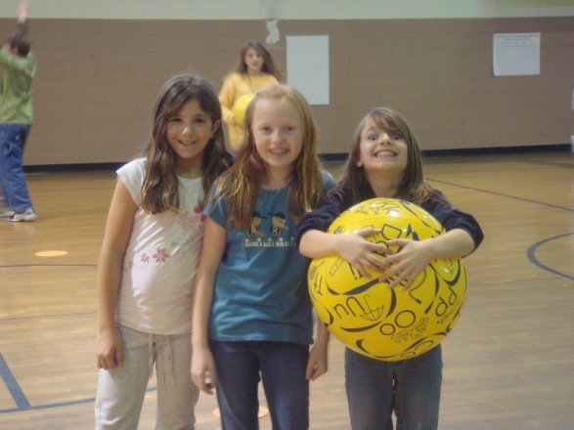
Curriculum Overview
Body Management
Manipulative Skills
Rhythmic Skills
Cooperative Education
Physical Fitness
Special Events
Click on a picture to learn more about the PE curriculum

Slide 8
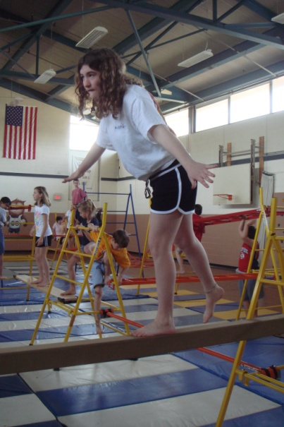
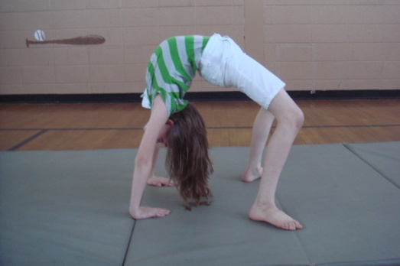
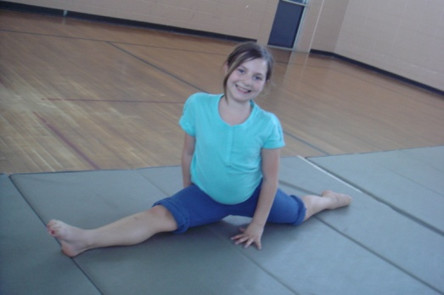
Body Management
Control body in a safe & effective manner
  Different ways to move or use body (running, hopping, skipping, twisting, stretching, etc.)
  Changing speed, levels, directions, and pathways
Click on this picture to learn more about Educational Gymnastics!
BACK

Slide 9
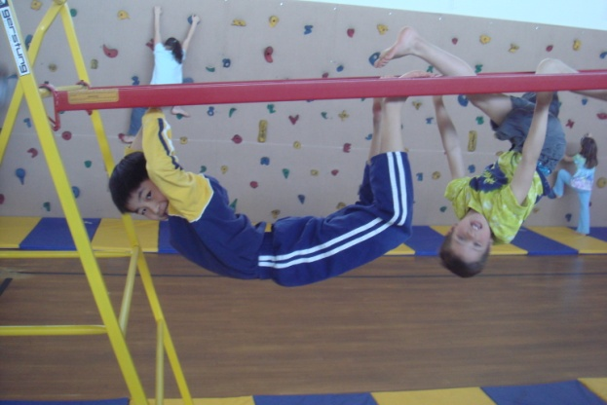
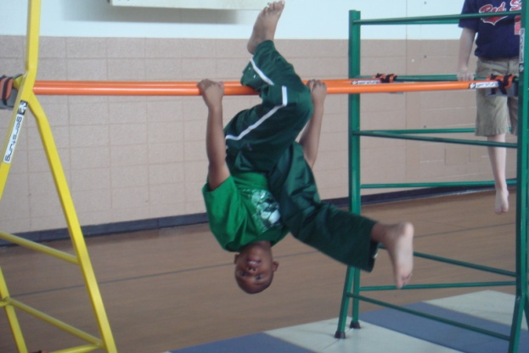
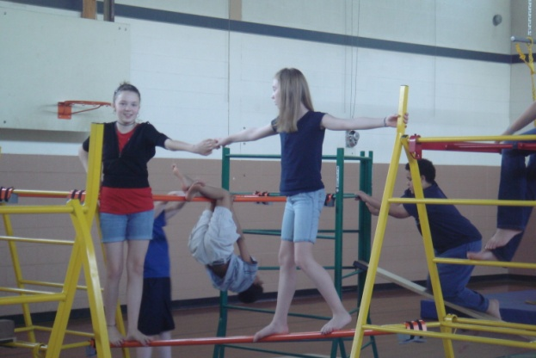
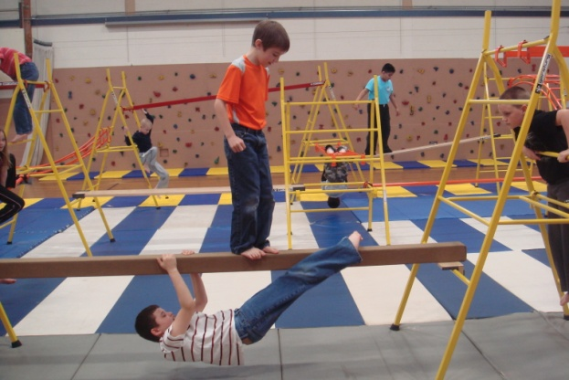
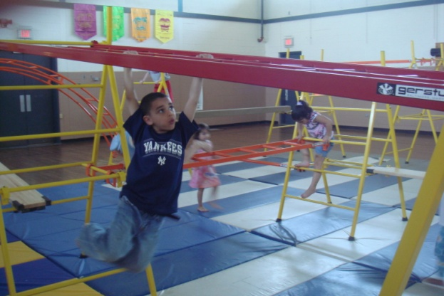
Educational Gymnastics
Whittle Apparatus
  Climbing, hanging, swinging, balancing, & much more
  Patterns & combinations lead to endless possibilities
BACK

Slide 10

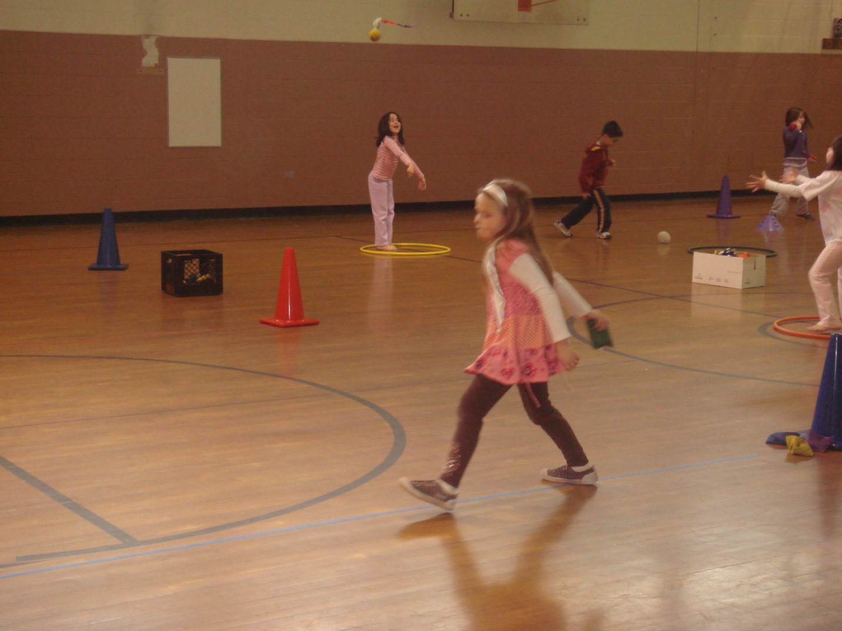
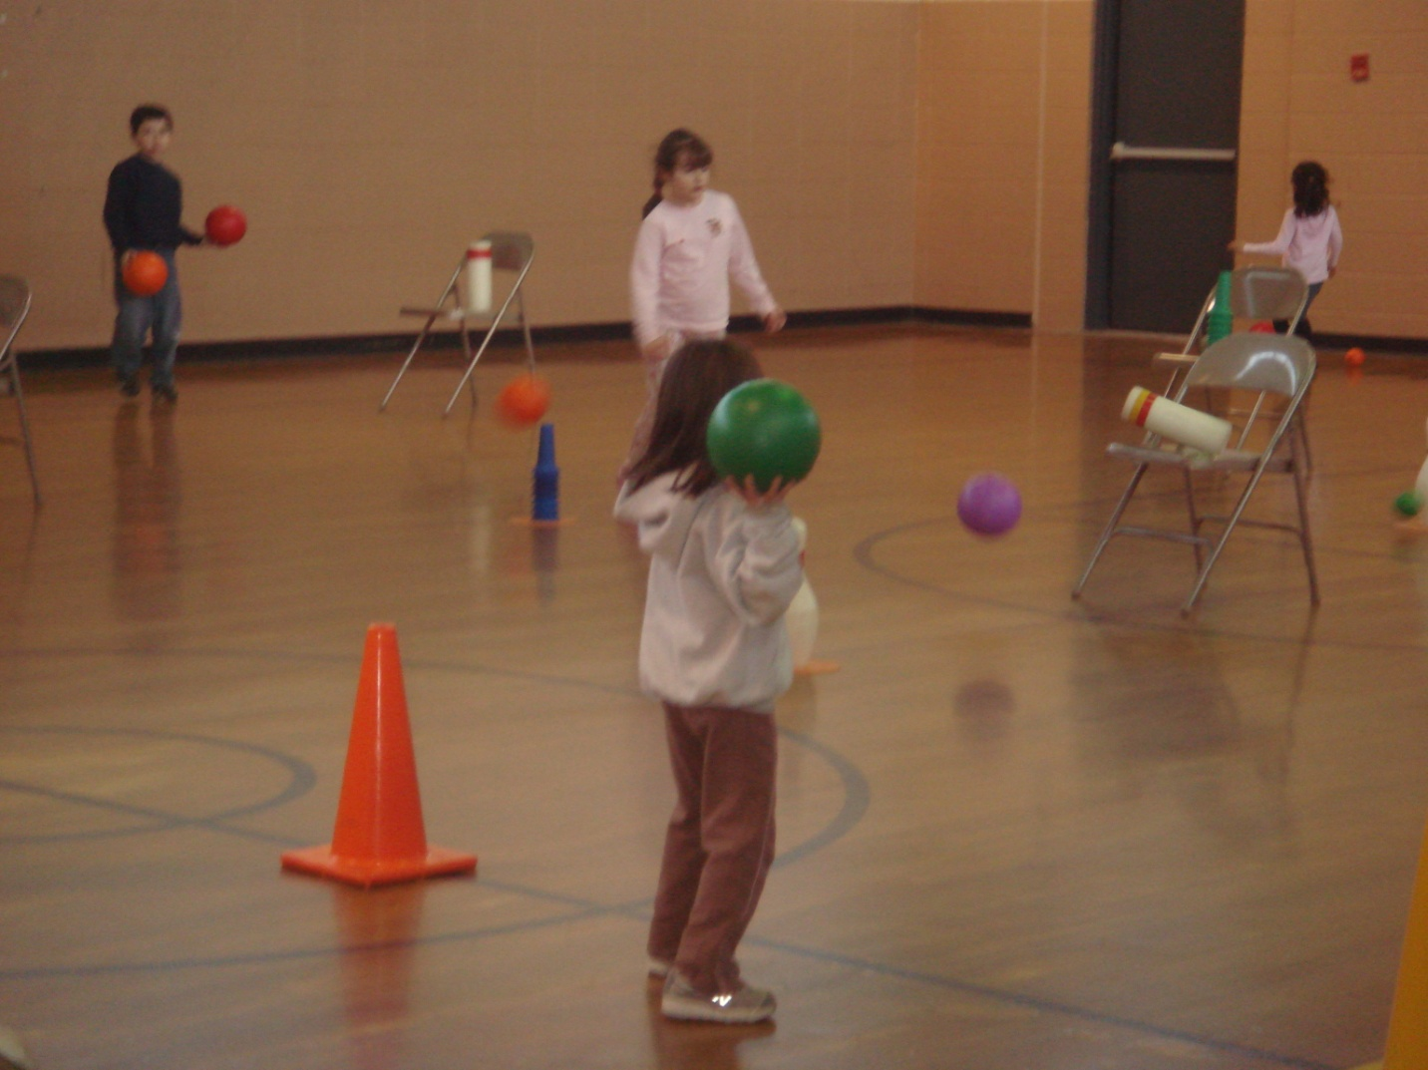
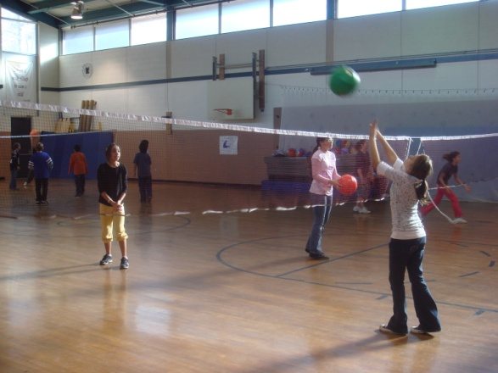
Manipulative Skills
Basic Skills:
  Throwing, catching, rolling, bouncing, dribbling, kicking, volleying, striking, and much more
Advanced Skills:
  Sport-specific – badminton, volleyball, bowling, hockey, soccer, frisbee, and much more
  Offense and defense, team games, circus skills
BACK

Slide 11

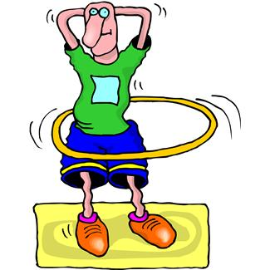

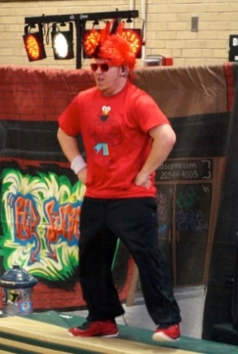

Rhythmic Activities
Creative Dance & Rhythm
  Students find beats & tempos & create movements
Hip-Hop Week
Red Supreme Visits
April 19-25
BACK

Slide 12

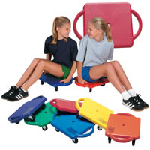
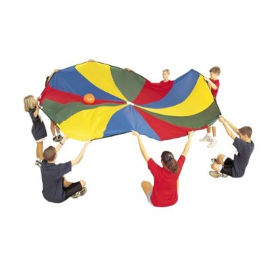

Cooperative Education
Teambuilding, problem-solving, cooperative games & “icebreakers”
  Parachute, scooters, initiatives, & more
Focus on responsibility, communication, respect, &
BACK

Slide 13

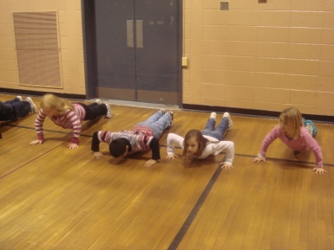
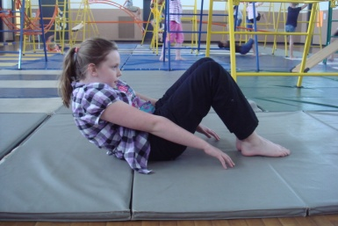
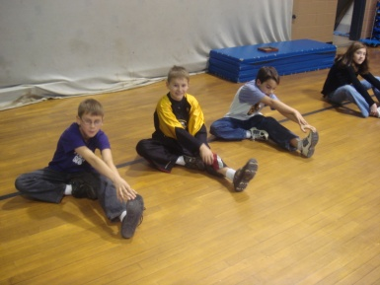

Physical Fitness
CT Physical Fitness Assessment
  Push-ups, curl-ups, stretching, & running
  Pre-class warm-up routine uses similar exercises
Students learn about fitness concepts, certain muscles, and many exercises
Click here to view testing standards, demonstration videos, and other useful information
BACK

Slide 14
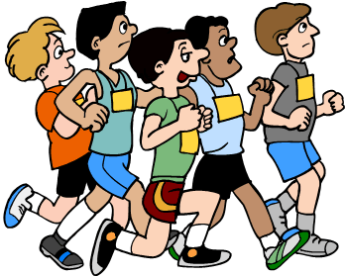


Special Events
Town-Wide Fun Run (new name)
Jog-a-Thon
Jump Rope for Heart
A.C.E.S.
Field Day
Click on a picture to learn more about each special event
BACK

Slide 15
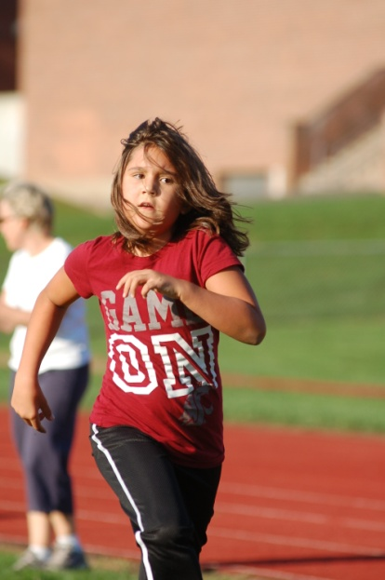
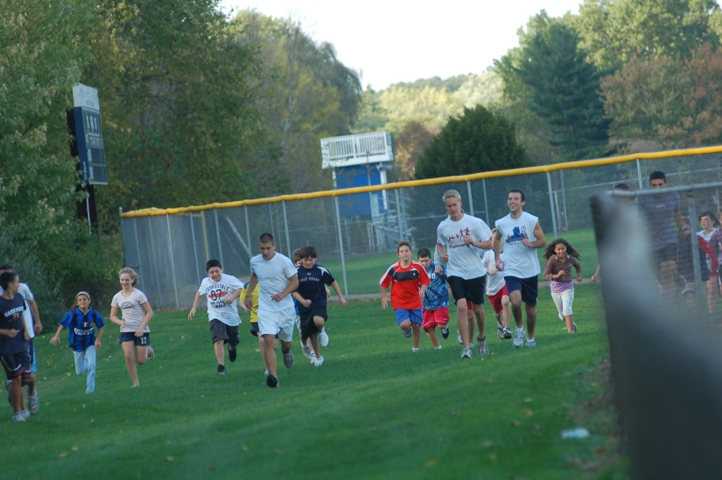
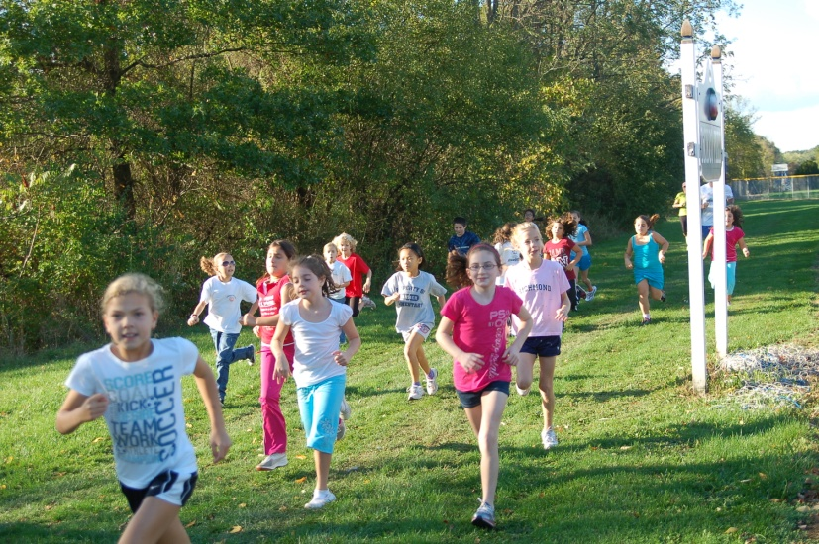
Town-Wide Fun Run
Every October!
  Wednesday, October 12th, 2016
1-Mile course for students in grades 4-6
  Help promote health and wellness!
BACK

Slide 16
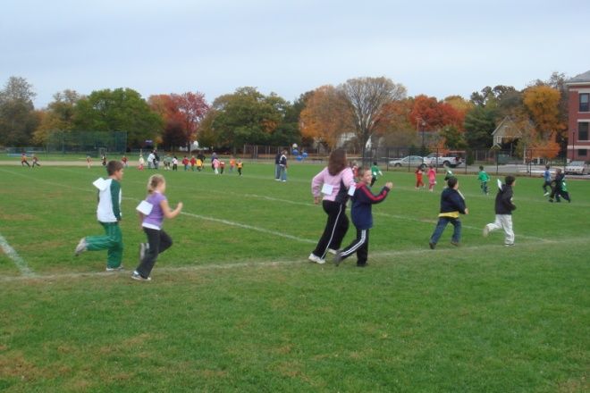
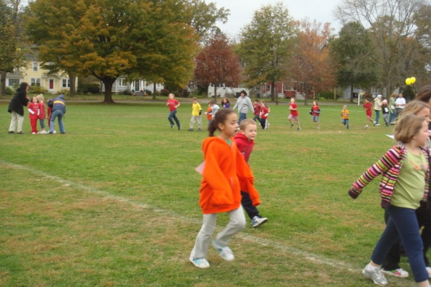
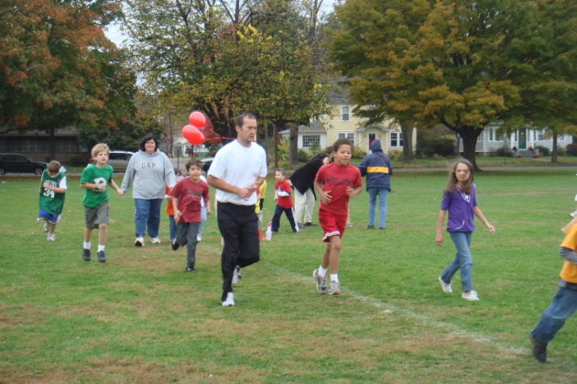
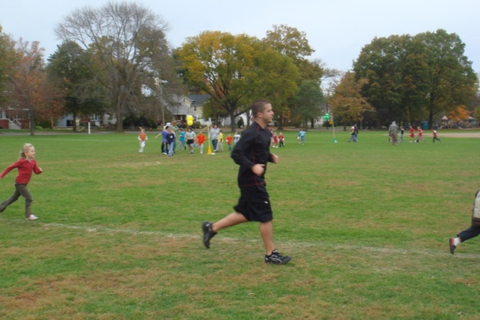
Jog-A-Thon
Every October! (run, walk, or jog for 30 min)
  Friday, October 7th, 2016 (rain date: Friday, October 14th)
Fundraiser to support enrichment programs
Last year, we ran over 618 miles and raised over $1500!!
BACK

Slide 17

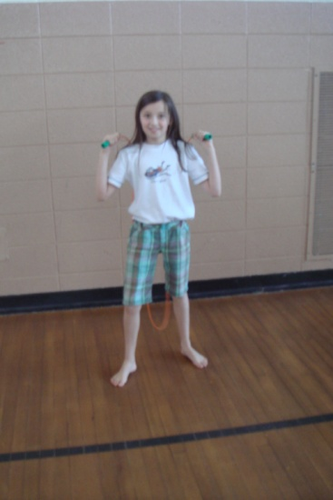

Jump Rope for Heart
Every February! (Heart Month)
  February 1st – 10th, 2017
Raises money for research to help the fight against cardiovascular disease and stroke
Click here to visit the website
BACK

Slide 18


A.C.E.S.
All Children Exercising Simultaneously
  Wednesday, May 3rd, 2017, 10:00 AM
Students, teachers, & staff members across the country enjoy 30 minutes of exercise to promote health and wellness
BACK

Slide 19
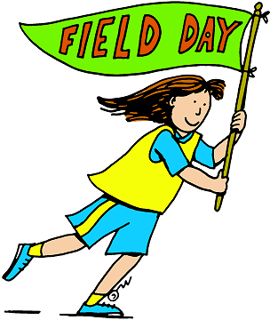
Field Day
Friday, May 26th, 2017 (rain date: Friday, June 2nd)
  9:45 AM – 12:30 PM
Highlights student learning & experiences
Brings school & community together to promote healthy & active lifestyles
BACK

Slide 20
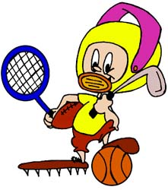
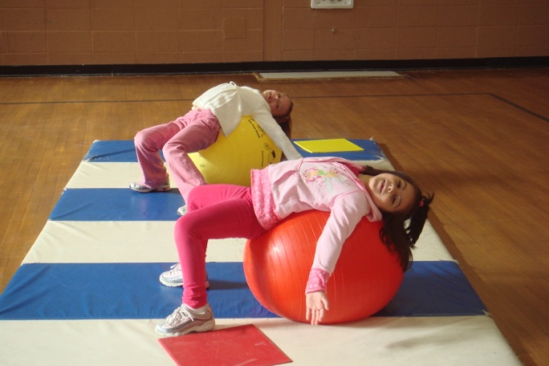
Afternoon Athletes
After-school program:
  Increase fitness levels through a variety of fun and exciting educational, cooperative, and competitive and non-competitive games and activities
Contact the Parks & Recreation Dept.:
  Phone: (860) 721-2890
  Website: Parks & Rec
Click here
NEXT

Slide 21


1st Annual Jingle Bell Run (tentative)
Friday, December 2nd, 2016 @ 4:00 PM
  At Hanmer (Please arrive by 3:45 PM)
This is a family event. All children must be accompanied by an adult.
Family Admission: 1 new unwrapped toy
(will be donated to the Wethersfield Social Services Department)
BACK
NEXT

Slide 22


Unified Sports
6 Weeks in February, March, & April
Elementary Skills Event:
  Saturday, April 1st, 2017 @ 9:30 AM
Come support our team!!
BACK

